Slide 1
Telesciences/ Geoscience:
Sornthep Vannarat, Shinji Shimojo,
Fang-Pang Lin
Pragma 28
2015 04

Slide 2
Update from NECTEC
Continue working on Raja Island
installed two lines of sensors on the east and the west sides of the island
simulation study of current patterns in the Indian Ocean and around the island
developing a data management system based on Erium
Applying sensors for disaster from flood and cold
about 100 sensor stations deployed in Chiangmai area
project hosted by Disaster Prevention Department
developed a data management and warning system
Notes:
User controlled Trust Envelope

Slide 3

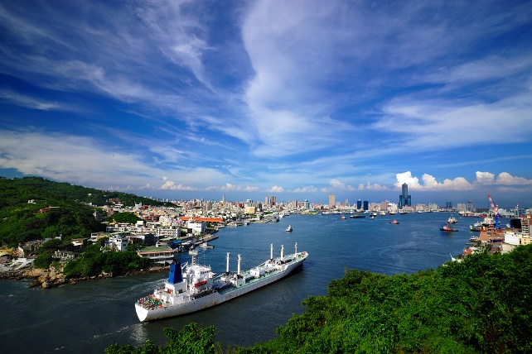
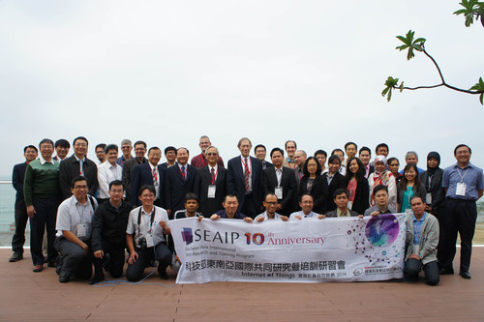
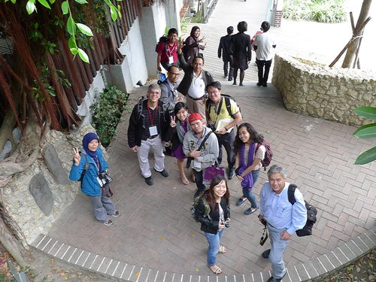
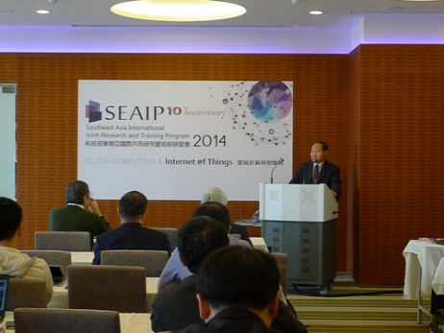
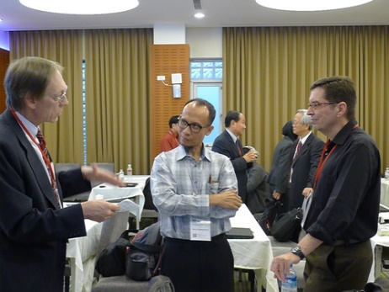
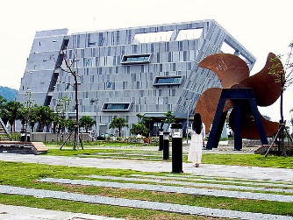
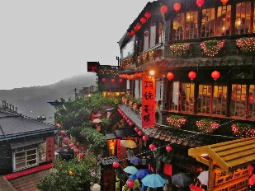
SEAIP 2014: 10th Anniversary
December 1-5@Tainan & Kaohsiung
~80 people attended
12 countries attend
Topic extended to Big Data & IoT
Jointly w/ PRAGMA Institute
We hope to do it again this year same week at Keelung! DO JOIN US….

Slide 4
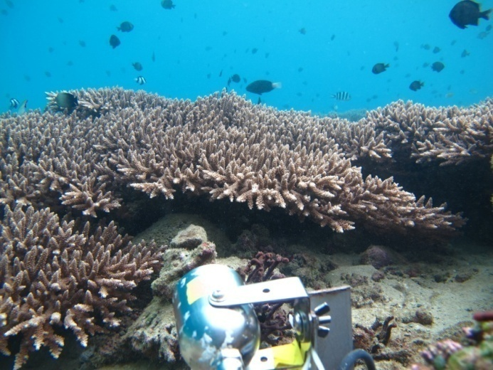
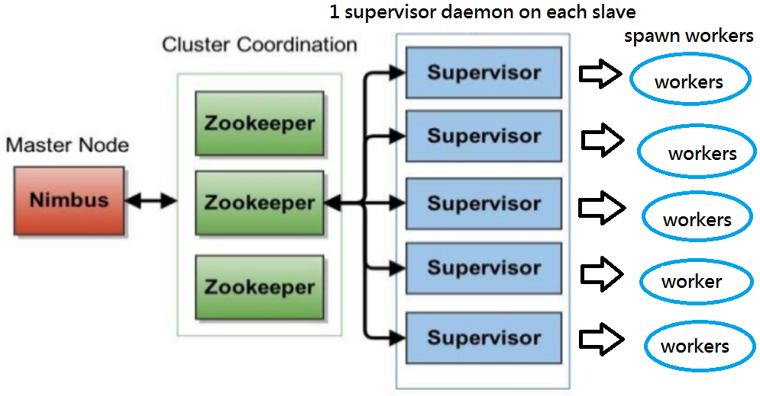
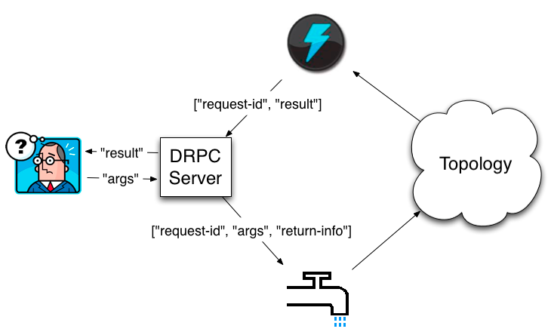
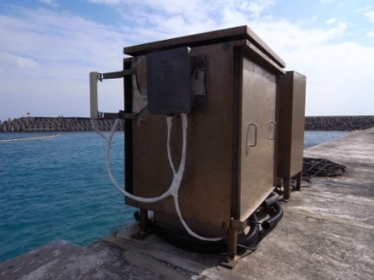
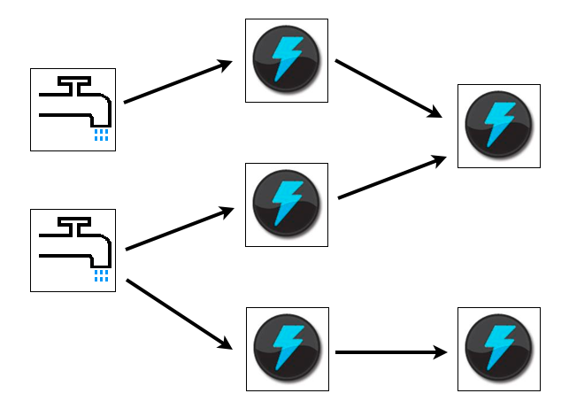
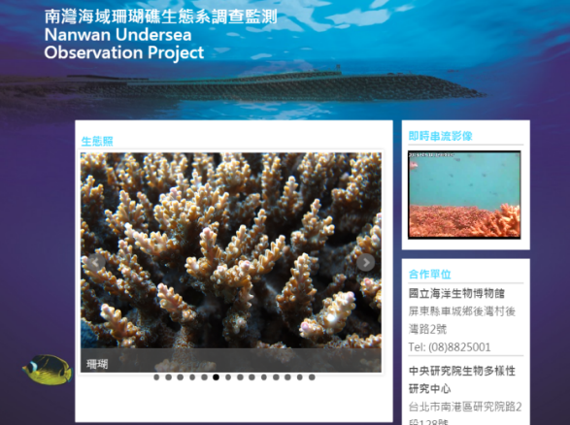
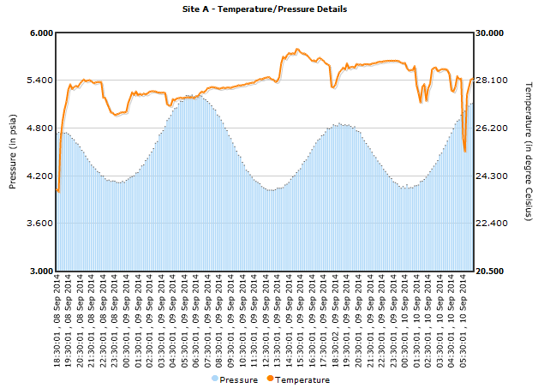
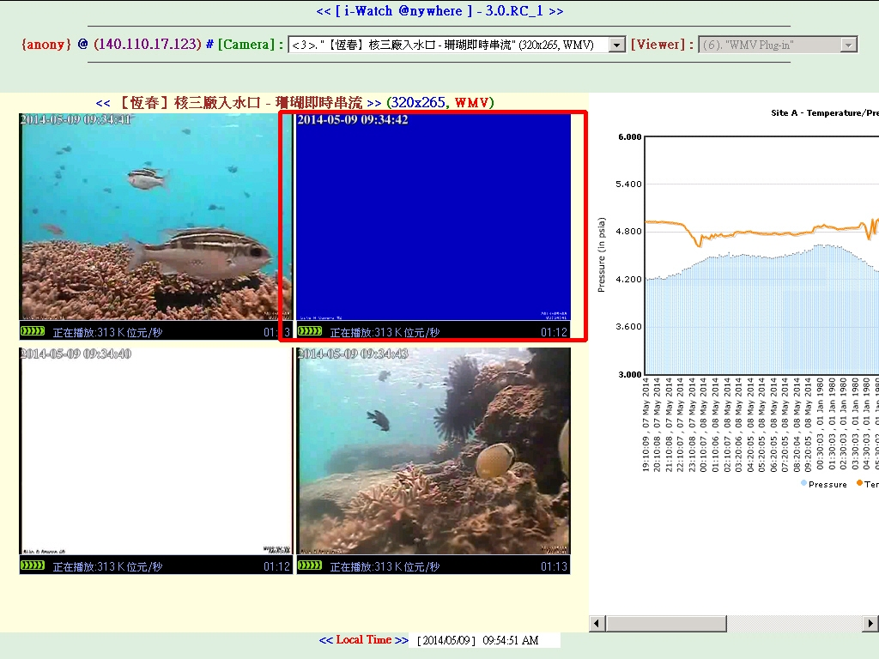
Storm for Data Streaming in Underwater Monitoring
Apache Storm to Analytics for real time
Underwater CCTV video processing – anomaly detection to help monitoring operational management in harsh environment.
- Fish4Knowledge in the future.
2. Temperature/pressure Statistics
We will test it on
PRAGMA ENT!

Slide 5
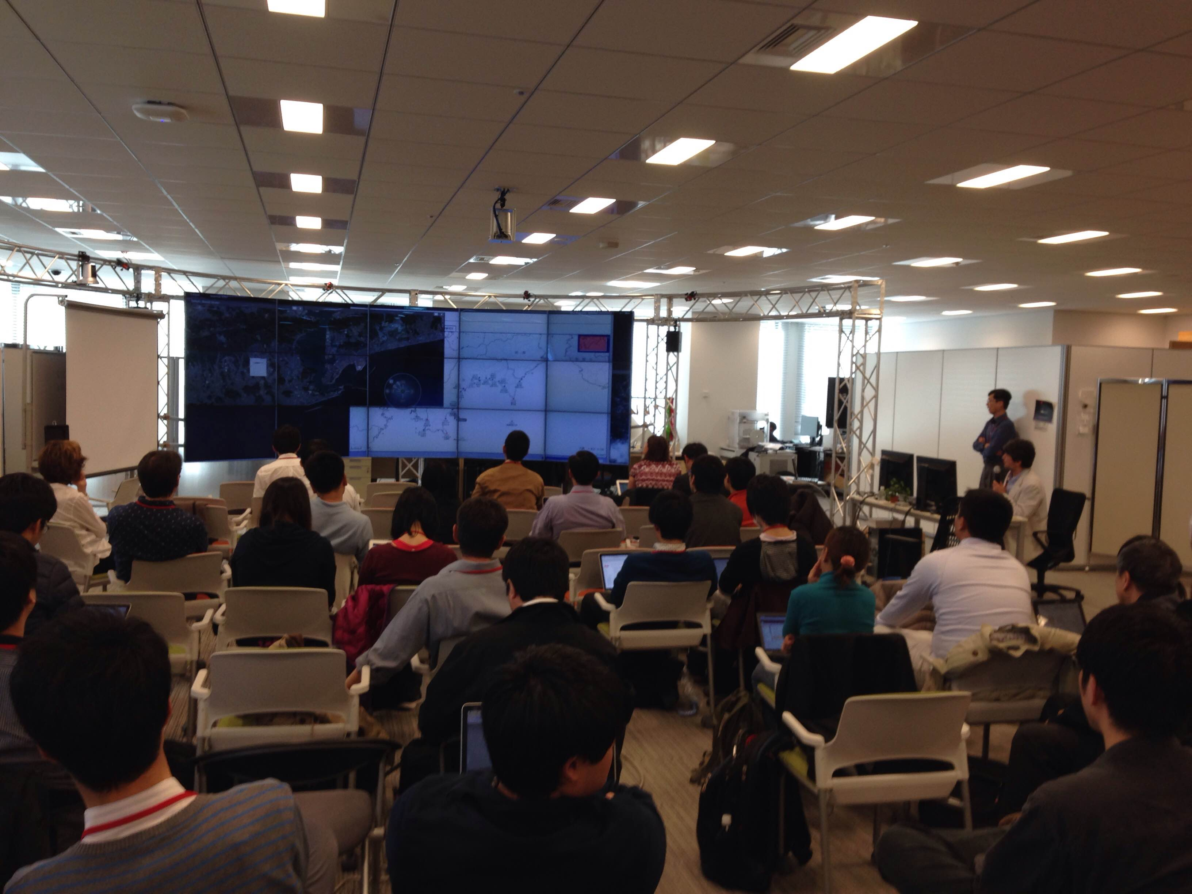
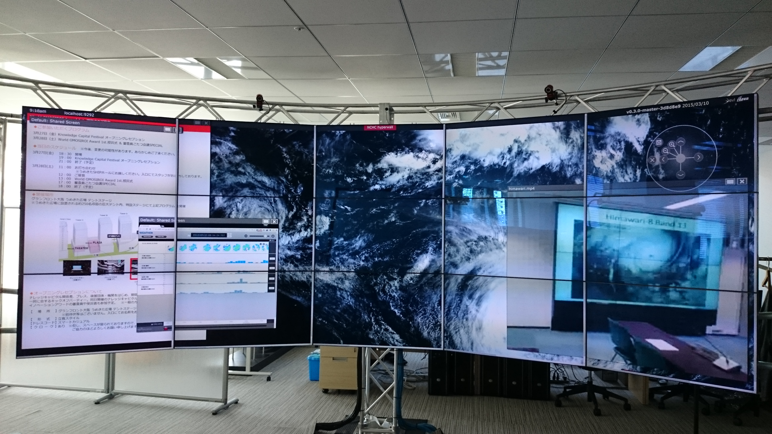
Network Intensive Application Demo Session
Disaster Mitigation by realtime analysis of TSUNAMI using federated supercomputers
Shinji Shimojo, Susumu Date, Yoshiyuki Kido, Masaharu Shimizu, Engr. Morsalin Uz Zoha (Osaka University), Hiroaki Kobayashi, Shunichi Koshimura, Ryusuke Egawa, Ryota Hino, Kenji Oizumi, Yusaku Ohta (Tohoku University), Akihiko Musa (Tohoku Univdrsity/NEC), Yoichi Murashima ( KOKUSAI KOGYO CO. LTD)
Demonstration of Meteorological Big Data Visualizations on TDW
Ken T. Murata, Eizen Kimura, Jin Tanaka, Takatoshi Ikeda, Eiji Kawai, Shinji Shimojo, Kohei Ichikawa, Yoshiyuki Kido, Susumu Date, Kentaro Ukawa, Kazuya Muranaga, and Takamichi Mizuhara
Satellite Image Trasmission
Ichikawa, Whey Fone
Thanks to SAGE2 and Pragma ENT

Slide 6
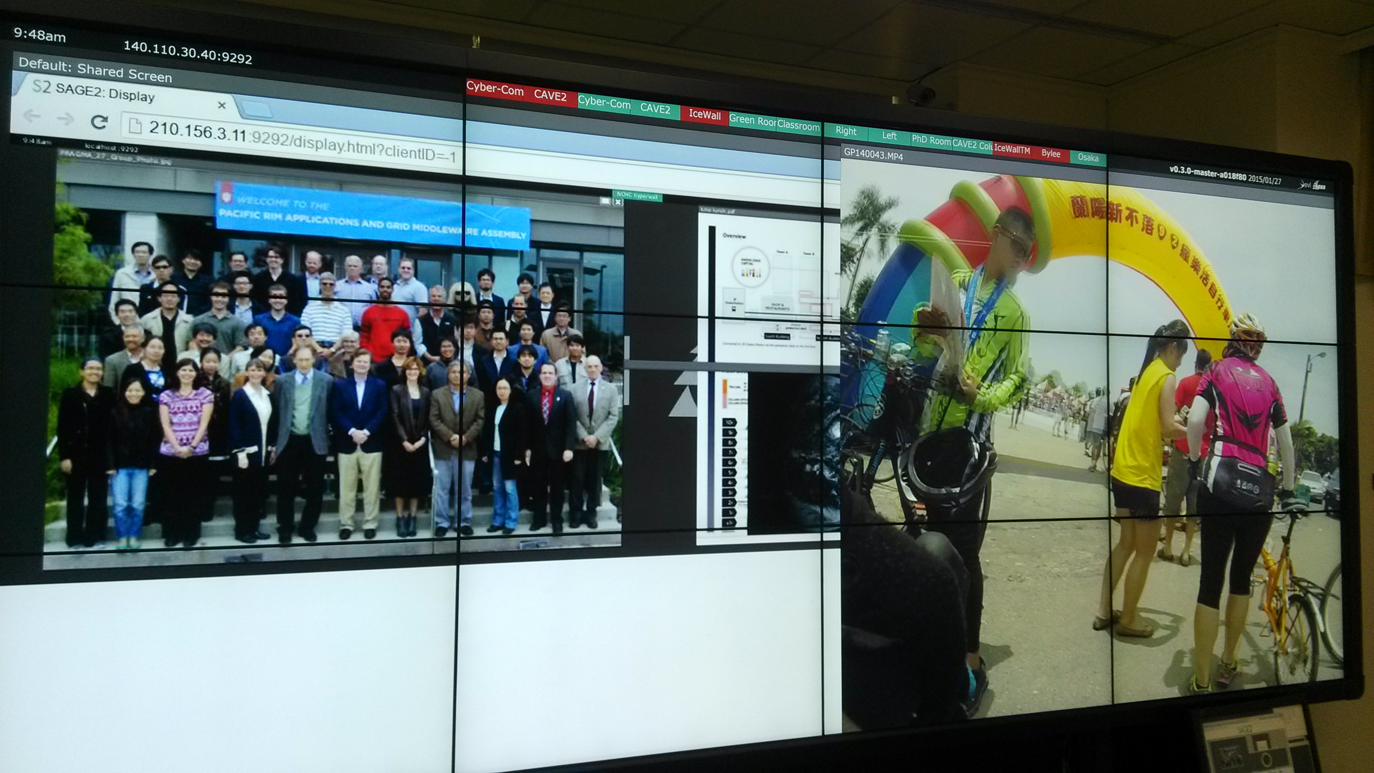
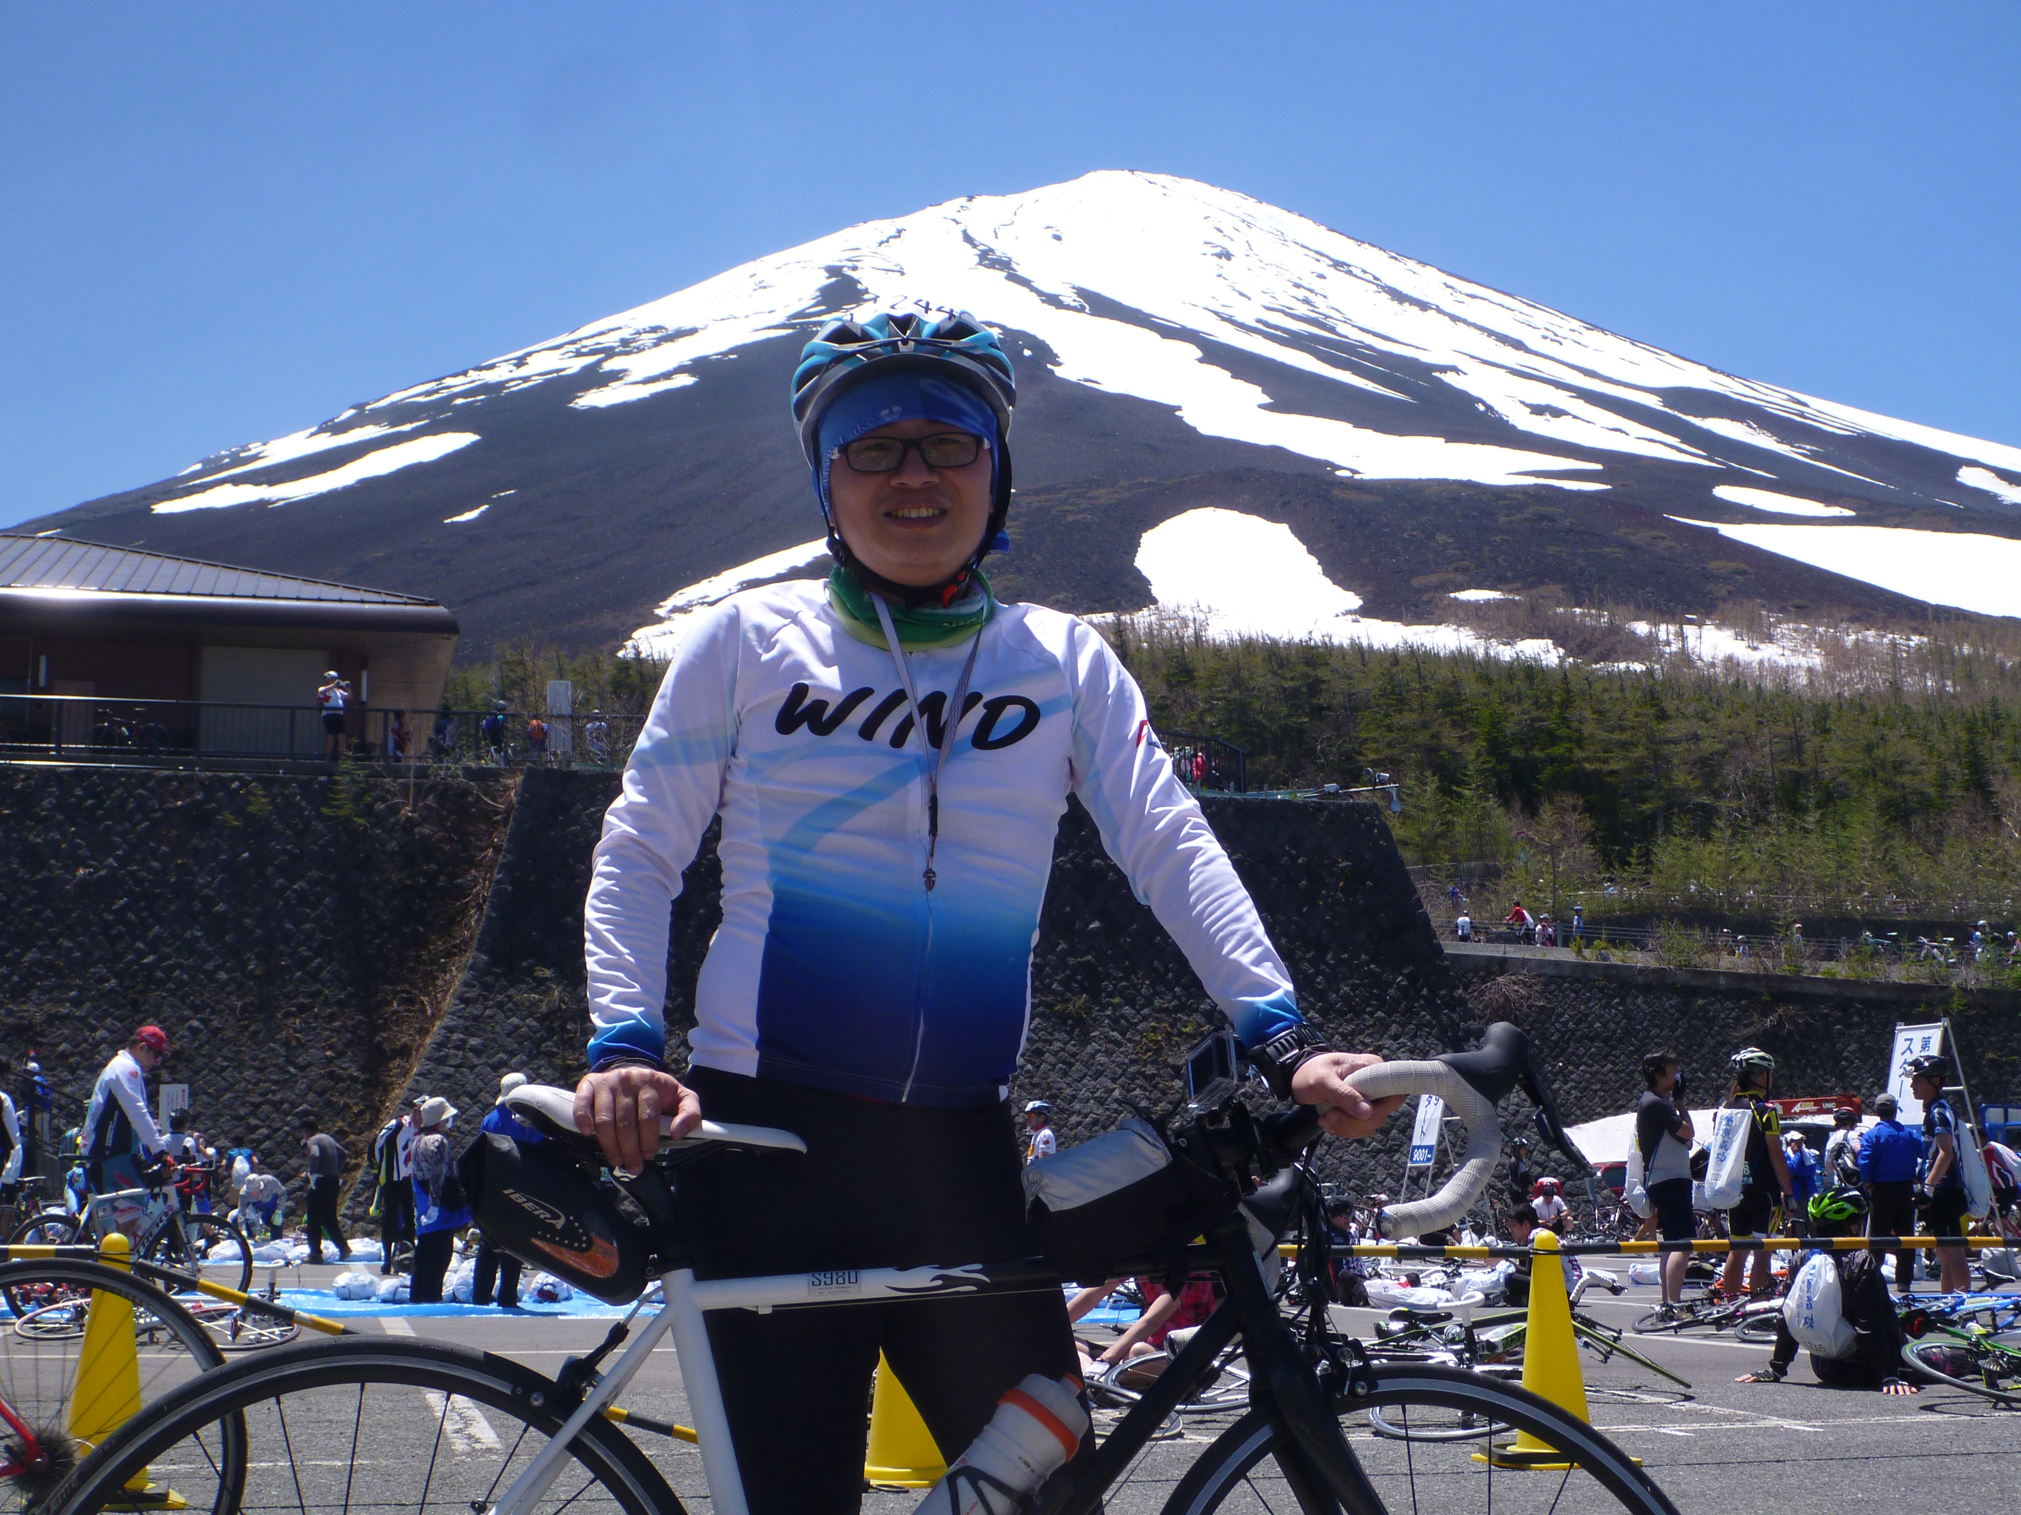
Connected to NCHC
Thanks to Whey Chon and BY Lee@NCHC

Slide 7

G空間津波浸水予測 阪大連携ネットワーク構成
2015/4/2
阪大
10.188.6.0/25
周辺サーバ用NW
VLANID: 3084
新規配線
10Gbps
フロントエンド
1Gbps(UTP)
.6
0
.14
10GBASE-LR
10GBASE-SR
3
ICX6610
-24-PE
#1,#2
10GBASE-CX4
周辺用ｴｯｼﾞ
ｽｲｯﾁ#49,#50
QFX3500
(qfx3500-49,50)
1
24
5
24
2
25
1
25
2
1
MX240
JGN-X
周辺用ｴｯｼﾞｽｲｯﾁ#2 QFX3500
(qfx3500h)
IP8800/
S2530
GS4000
５
172.25.41.0/25
クラスタ運用NW3
VLANID: 81
※JGN L2VPNは、SX-9連携実験時の使用L2セグメントを使用
12
JGN-X VLAN
VLAN 1409
4
.80
０
4
.7
172.20.12.0/27
実験用新セグメント
データ転送サーバ
QX-S5732P
(qxs5732p)
.66
IP8800
(ip8800GN)
新規配線
IP8800
(ip8800KN)
※2015/3末撤去予定
130.34.244.64/28
TAINSグローバル
VLANID: 4
StarTAINS
FortiGate
東北大

Slide 8
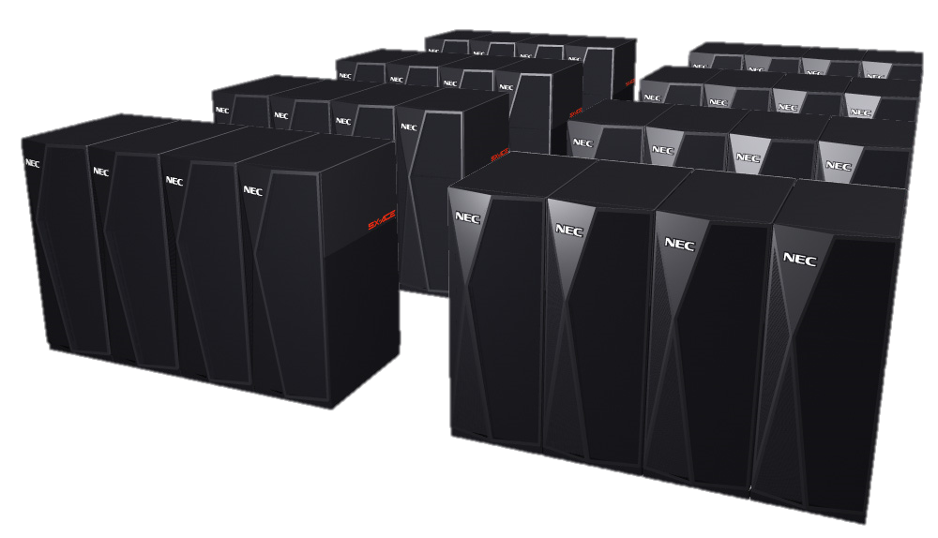
System Configuration
IRIDeS
Tohoku University
CyberScience Center
Osaka University
処理指示・データ送受
Data Transmission
Server
Job Submis
Result
JMA
災害研
サーバA
SuperComputer
SX-ACE
EarthQauke Information
断層データ
災害研
サーバB
処理指示・
データ送受
Cybermedia Center
Osaka University
Local Goverment
FrontEnd Server
Prediction Information
SuperComputer
SX-ACE
Job Submission
Result

Slide 9





FEderated interoperable SmarT ICT services deVelopment And testing pLatforms
下條真司

Slide 10
Things we will discuss
Updates
What is the role of infrastructure for your application ? Ex. Pragma-ENT, Resouces
System Issues
Policy enforcement
Dynamic Change in System Configuration with Network
Federation on International Network

Slide 11
Knowledge/Experience to be shared
Raja Island (Sornthep)
Satellite Image Transfer (Whey-Fone)
Stream Data processing for sensors (Fang-Pang)
Terra Green Network – Citizen science for mapping trees. (Jung-Hwang)
Sensor Network development in ASTI (Julian)

Slide 12
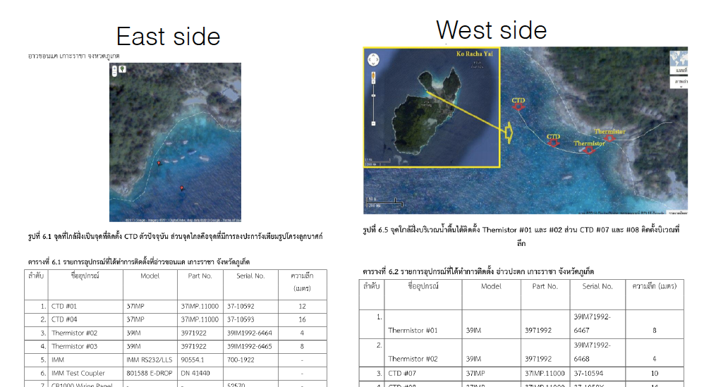
NECTEC

Slide 13
Storm Cluster, Topology and DRPC
Fang-Pang Lin
Topology
Tuple
Tuple
Bolt
Spout
Bolt
Tuple
Tuple
Bolt
Spout
Tuple
Storm Cluster
Tuple
Bolt
Bolt
DRPC (Distributed Remote Procedure Call

Slide 14
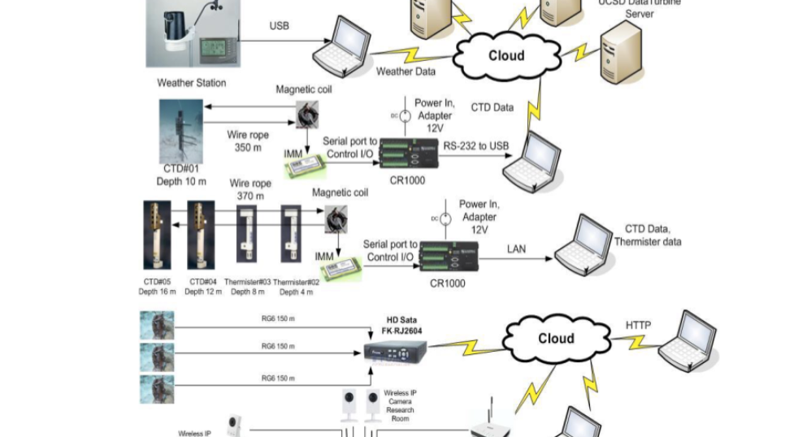
NECTEC

Slide 15
Requirement for Resources
Co-existence of stable and robust resources and breakable resources
Security and System Configuration Issues
Specially important that entire system can be configured repeatedly in software defined.
Security issue can be considered separately when we use network virtualization.
There is a new streaming computational model coming to intention to treat realtime sensor data processing.
Balance of requirements for data stream, computational power and communication should be carefully considered and arranged.

